Slide 1
Face Mask with Fashion
Fashion with safety

Slide 2
Characteristics of Face Mask
Medical Mask
Civilian Mask
  Cotton Mask
  Non Woven Mask
  Polymer Material Mask
A civilian mask is used for the purpose of filter air into the mouth and nose to prevent harmful gases, odours, and droplets from entering and leaving the wearer’s mouth and nose.

Slide 3
Quality Check point for Civil Mask
Smell Test
Water repellency
Bacteria Growth

Slide 4
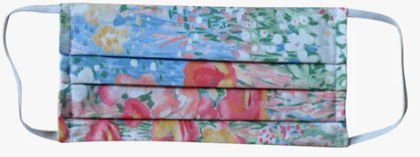
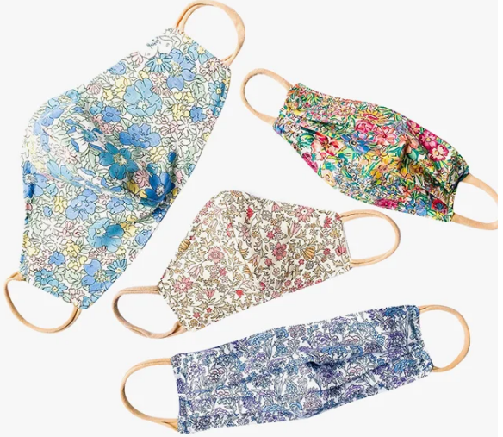

Slide 5
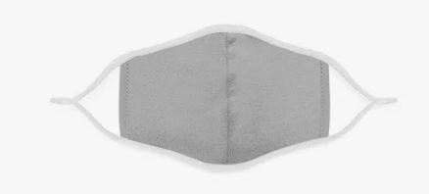

Slide 6
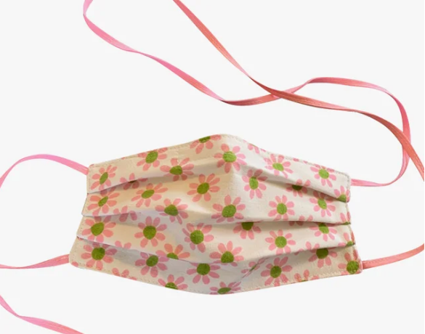

Slide 7
